Slide 1
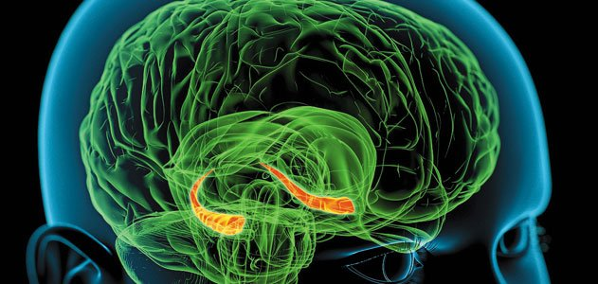
Memory & Learning
Robert Payo
Robert.payo@dmns.org

Slide 2
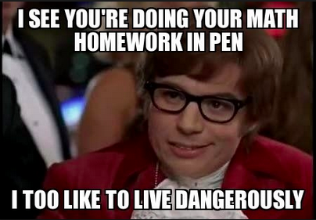
How might we make learning math easier and more memorable for everyone?

Slide 4
Can you increase the number of objects you can remember?
Come up with 3 different ways that you could improve your score—without cheating ;)
0:58
0:57
0:56
0:55
0:54
0:53
0:52
0:51
0:50
0:49
0:48
0:47
0:46
0:45
0:44
0:43
0:42
0:41
0:40
0:39
0:38
0:37
0:36
0:35
0:34
0:33
0:32
0:31
0:30
0:29
0:28
0:27
0:26
0:25
0:24
0:23
0:22
0:21
0:20
0:19
0:18
0:17
0:16
0:15
0:14
0:13
0:12
0:11
0:10
0:09
0:08
0:07
0:06
0:05
0:04
0:03
0:02
0:01

Slide 5
Can you remember?
…the first time you learned to ride a bike?
…your best friend’s phone number?
…the capital of California?
…how to walk like a penguin?
…which months have 31 days?
… what 9 x 12 is?
…how to copy and paste text in a document?
Notes:
Are these all the same type of memory?
What categories would you put them in?

Slide 6
Types of Memory: 2 Basic Types
Declarative: (Knowing what) Facts, dates, faces, or personal events I remember
Procedural: (Knowing how) Recalling how to do something—becomes automatic
Which type of memory are you using when you study integers and irrational numbers?

Slide 7
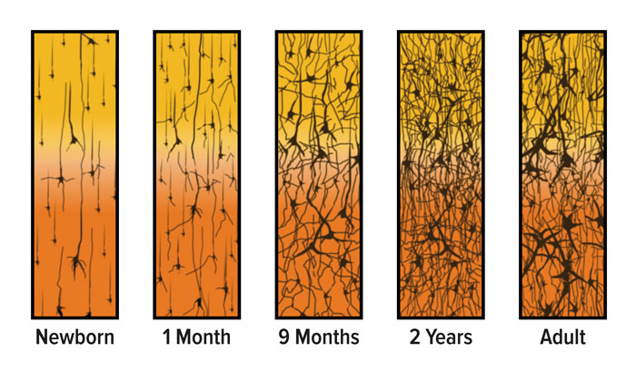
Neuron Growth and Connection over time
?
?
Source: Corel, JL. The postnatal development of the human cerebral cortex. Cambridge, MA: Harvard University Press; 1975

Slide 8
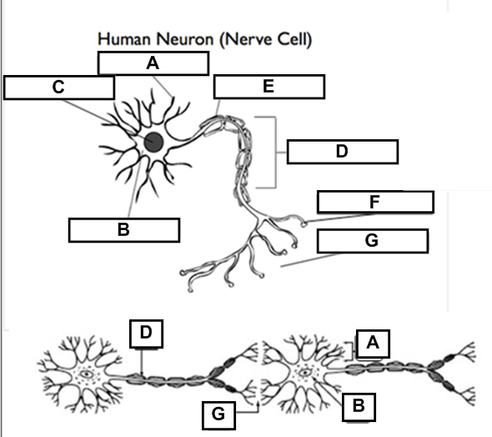
Brain Wiring- Neurons
Dendrite
Cell Body
Nucleus
Axon
Myelin Sheath
Terminal Button
Synapse

Slide 9
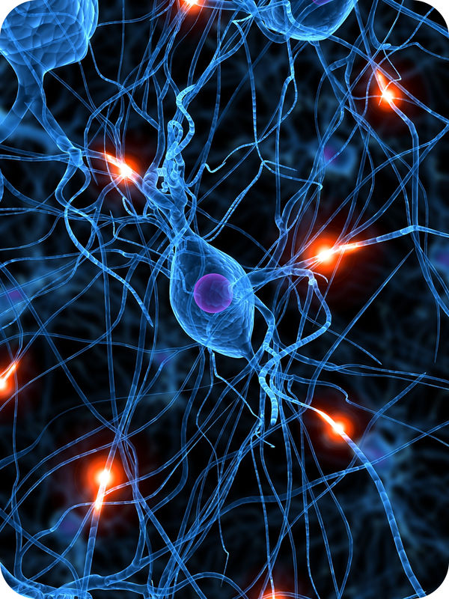
Pass the Impulse Game
When I say “Go”, pass the impulse as shown
Time your team
Record your time
See if you can beat your time in a second round
Record your new time

Slide 10
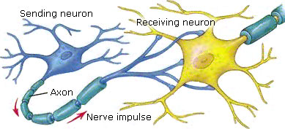
What makes a learning experience sticky?
Dendrites:
Receive impulse
Synapse: Where nerves communicate with one another
Neurons fire then wire connections
When you repeat a thought or action, you strengthen the speed and connection between a given set of brain cells or neurons.

Slide 11
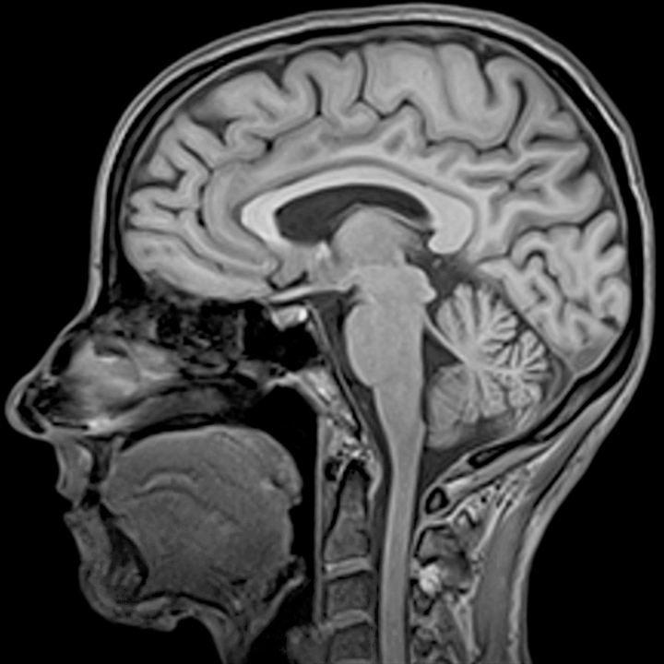
CAT Scan
Cerebrum
Cerebellum
Brain stem
Notes:
Xrays taken cross sectional, taken at different angles to get 3D imaging

Slide 12
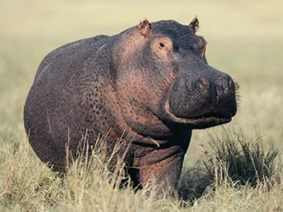
Memory & Learning
Hippocampus:
Memory
Amygdala:
Emotion

Slide 13
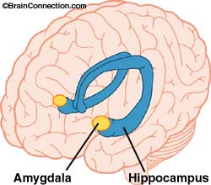

Slide 14
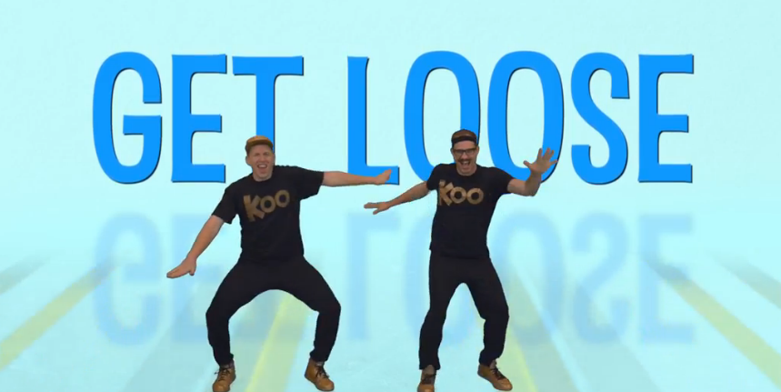
Brain break
https://www.gonoodle.com/channels/koo-koo-kanga-roo/i-get-loose

Slide 15
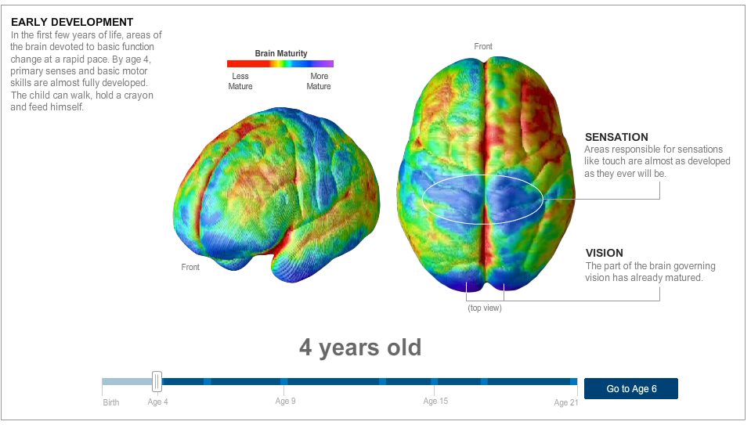
http://www.nytimes.com/interactive/2008/09/15/health/20080915-brain-development.html

Slide 16
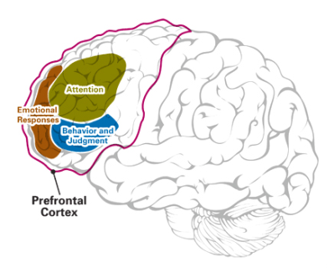
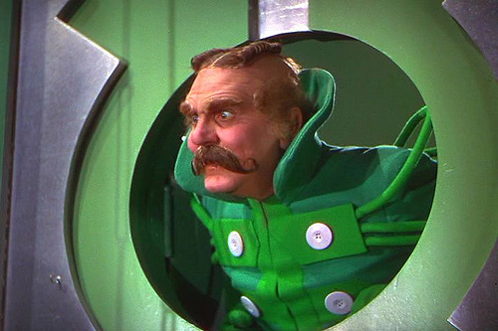
What makes a learning experience sticky?
Attention is the Gatekeeper
Attention determines what neurons are going to fire and if it will go further into your memory network

Slide 17
What makes a learning experience sticky?
Attention is
the Gatekeeper
Consider:
Our attention spans are limited
Our attention spans can be strengthened with practice

Slide 18
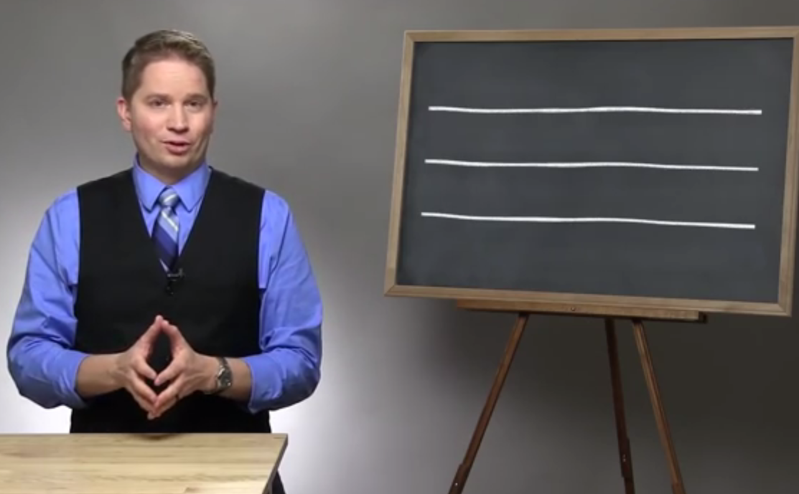
True or False: Our brains can do two tasks simultaneously
https://www.youtube.com/watch?v=BCeGKxz3Q8Q

Slide 19
How might we make learning math easier and more memorable for everyone?
What makes a memory sticky?

Slide 20
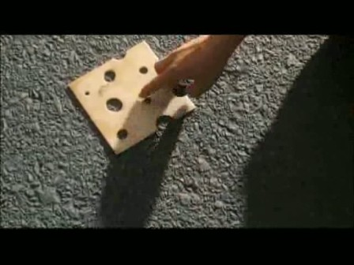

Slide 22
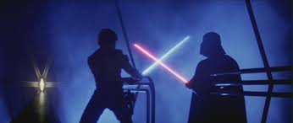

Slide 23
Diary of a Wimpy Kid

Slide 24
The Lion, the Witch, and the Wardrobe

Slide 25
Star Wars: The Empire Strikes Back

Slide 26
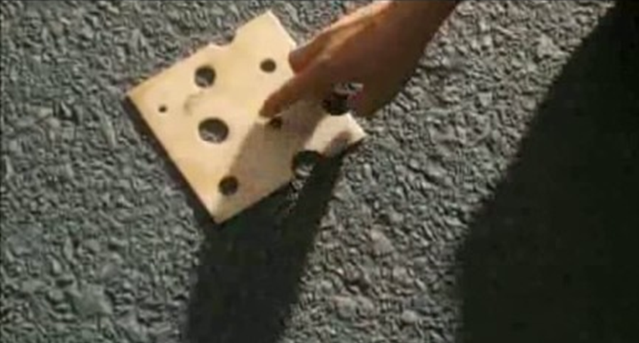
What enabled you to retrieve the names of these movies? (or not)

Slide 27
What enabled you to retrieve the names of these movies? (or not)
Emotional response to the film
Previous experience/knowledge
Repeated viewing
Viewing repeatedly over long periods of time
Strong sensory inputs: (special effects, stinky cheese)
Elaborating on the memory by connecting it to other contexts (reading the books, cinematography, film history)
Social and physical reinforcement of memory (discussing, reciting, re-enacting)
Associative elements of the experience (genre, actor or director, a catch phrase, who you were with, where you saw it, etc)

Slide 28
What makes a learning experience sticky?
Emotional responses
Previous experience/knowledge
Repeating to remember
Repeated reinforcement over longer periods of time
Strong sensory inputs
Elaborating on memory by connecting it to other contexts, patterns, meaning
Social and physical reinforcement of memory (discussing, reciting, re-enacting, modeling, teaching)
Associative elements of the experience

Slide 29
Biography of a Memory: Storing a Memory
Encoding
Storage
Sensory Input
Short-Term Memory
Long-Term Memory
Consolidation
Working
Memory
Often dependent upon: interest, previous knowledge, emotion

Slide 30
Long Term: Retrieval & Reconstruction of a Memory
Short-Term Memory
Long-Term Memory
Recall
Recognition
Meaningful association

Slide 31
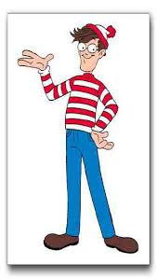

Slide 32
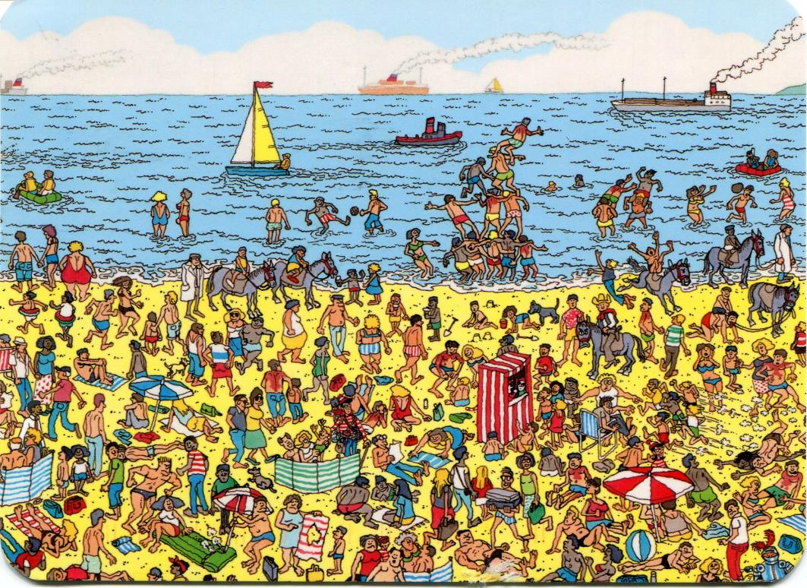

Slide 34
How might we make learning integers and irrational numbers easier and more memorable?
What makes a memory sticky?

Slide 35
Fill out the survey
Be honest
Write down your first, immediate answer
Answer the questions after the survey

Slide 36
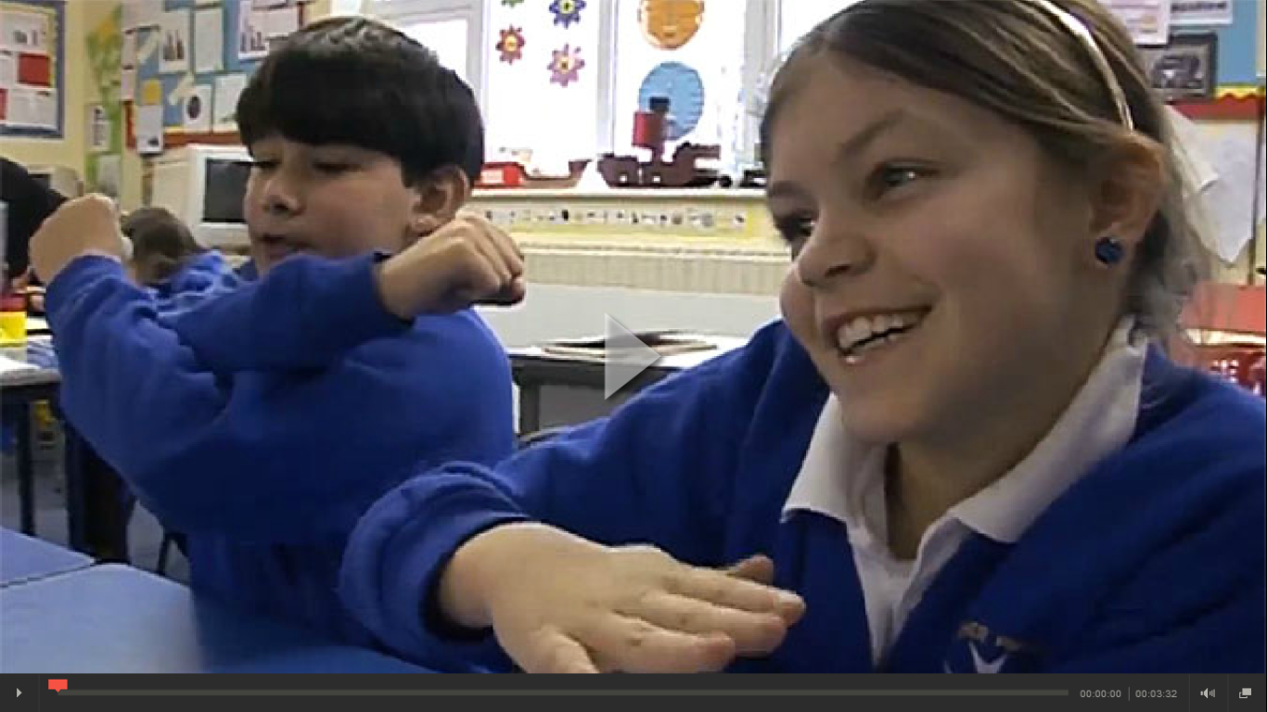
https://www.teachingchannel.org/videos/teaching-math-hand-gestures

Slide 37
What do you see and hear that show that the kids are learning?
How does it help them learn?

Slide 38
Fishbowl: Guidelines
What does a good discussion look like?
How are you as an audience member going to help create a productive and useful discussion?
What are we looking for to help with our PBL?
0:58
0:57
0:56
0:55
0:54
0:53
0:52
0:51
0:50
0:49
0:48
0:47
0:46
0:45
0:44
0:43
0:42
0:41
0:40
0:39
0:38
0:37
0:36
0:35
0:34
0:33
0:32
0:31
0:30
0:29
0:28
0:27
0:26
0:25
0:24
0:23
0:22
0:21
0:20
0:19
0:18
0:17
0:16
0:15
0:14
0:13
0:12
0:11
0:10
0:09
0:08
0:07
0:06
0:05
0:04
0:03
0:02
0:01

Slide 39
https://www.teachingchannel.org/videos/math-teaching-techniques

